Slide 1

Diabetes Risk Prediction from Personal Health Indicators
DSE-230
Project Proposal Presentation
Team 3:
Chunxia Tong
Camm Perera
Sergey Gurvich

Slide 2

Problem Definition
Diabetes: Background
Quick Facts:
37.3 million US adults have diabetes, and 1 in 5 of them don’t know they have it.
Diabetes is the seventh leading cause of death in the United States.
Diabetes is the No. 1 cause of kidney failure, lower-limb amputations, and adult blindness.
In the last 20 years, the number of adults diagnosed with diabetes has more than doubled.
Source: https://www.cdc.gov/diabetes/basics/diabetes.html
Risk Factors:
Smoking: 19.8% were tobacco users based on self-report or levels of serum cotinine.
Overweight and Obesity: 89.8% were overweight or had obesity, defined as a body mass
Physical Inactivity: 34.3% were physically inactive
Family history: Risk increases if a parent or sibling has type 2 diabetes
Race or ethnicity: Black, Hispanic, American Indian and Asian American people — are at higher risk
Source: https://www.cdc.gov/diabetes/data/statistics-report/risks-complications.html
Health Complications:
Heart disease
Chronic kidney disease
Nerve damage
Other problems with feet, oral health, vision, hearing
Mental health
Source: https://www.cdc.gov/diabetes/managing/problems.html
DSE-230 Team 3 Project Proposal

Slide 3

Problem Definition
Proposal: Diabetes Disease Risk Prediction Based on Personal Health Indicators
Possible Applications:
Medical
Prevention
Cost Reduction
Treatment Improvement
Source: https://www.lumahealth.io/
Insurance
Calculating Risks Adjustments for Medical Plans Pricing
DSE-230 Team 3 Project Proposal

Slide 4
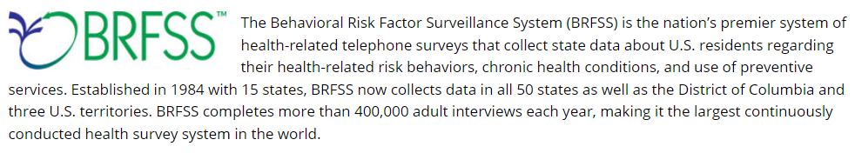

Dataset Description
Source: https://www.cdc.gov/brfss/index.html
Original Dataset Files, Scripts and Description: https://www.cdc.gov/brfss/annual_data/annual_2020.html
Collection method – annual phone survey (2016-2020)
Question Examples:
(Ever told) (you had) diabetes?
Do you now smoke cigarettes every day, some days, or not at all?
During the past month, other than your regular job, did you participate in any physical activities or exercises such as running, calisthenics, golf, gardening, or walking for exercise?
Calculated Variables Examples:
Calculated variable for fourteen-level age category (1-14)
Calculated variable for income categories (1-9)
Body Mass Index
Source: https://www.wikihow.com/Conduct-a-Telephone-Survey
DSE-230 Team 3 Project Proposal

Slide 5
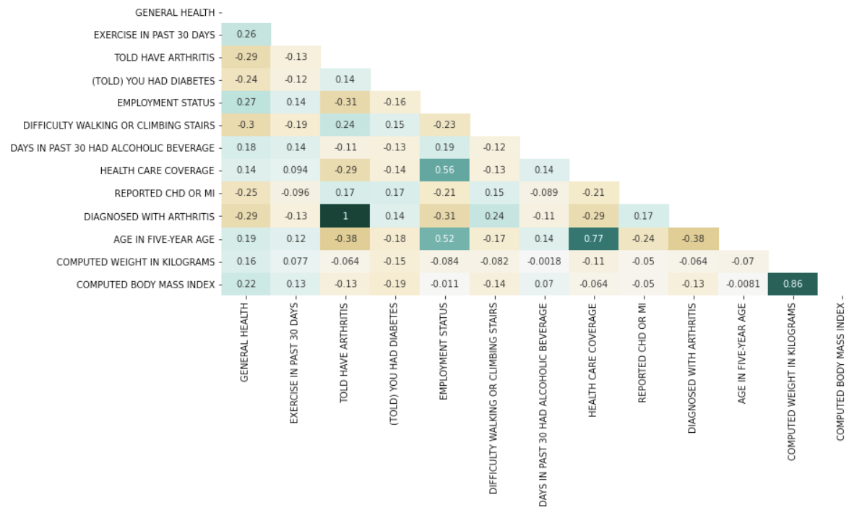
Insights to be gained
Find a feature (or combination of features) that affect the chances of developing diabetes disease:
Example: diabetes risk level should decrease with exercise, but it can increase with such underlying conditions as heart disease or arthritis
DSE-230 Team 3 Project Proposal

Slide 6
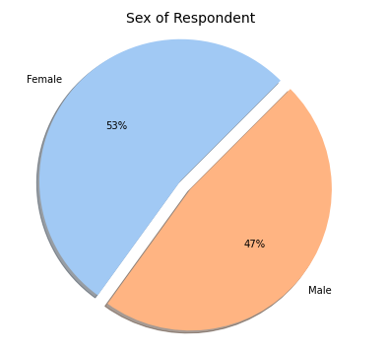
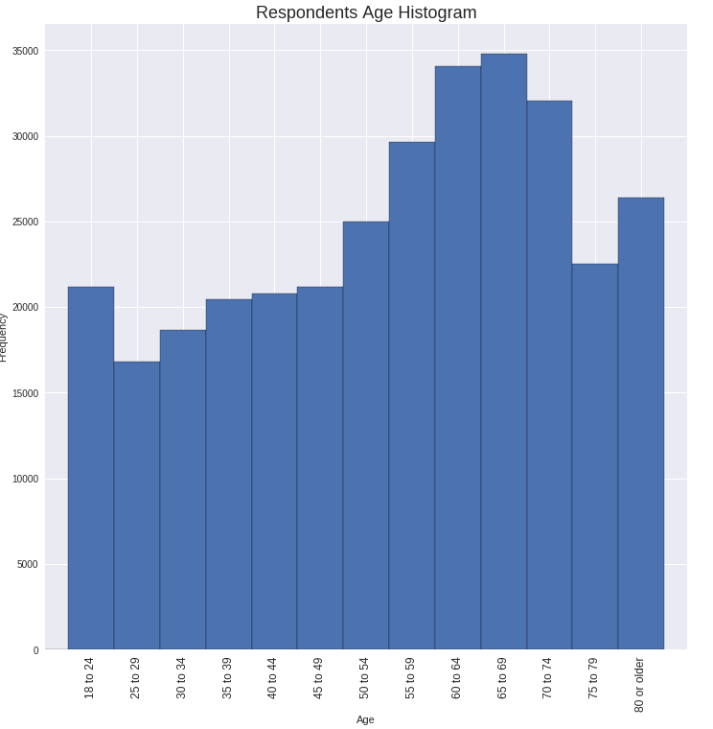
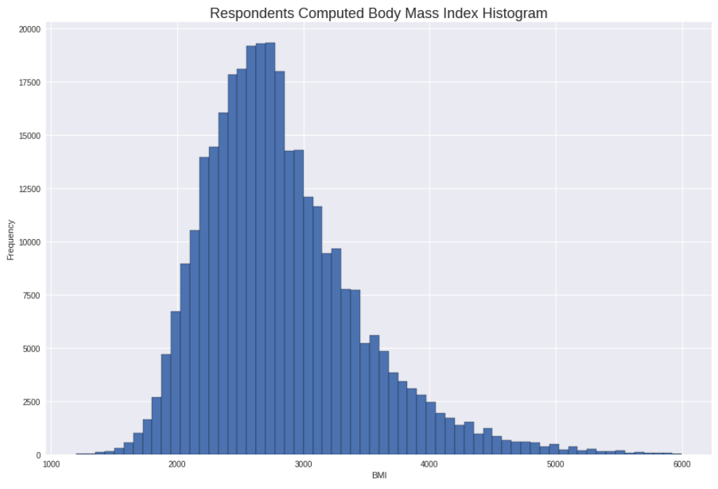
Analysis Task to Perform
Data Preparation
Non-sparse feature selection
Remove rows with blank values (nulls/NAs)
---------------------------------------------------------
(400k x 279 -> 327k x 112)
Remove irrelevant features (Survey date, Phone number etc.)
Remove non-contributing features/highly correlated features
Remove rows with non-contributing answers (‘refuse’)
Scaling
Remove outliers
Recoding Features
EDA
Data exploration
Data visualization
Summary statistics
Modeling
Classification (binary)
DSE-230 Team 3 Project Proposal

Slide 7

Potential challenges with data and/or task
The provided data is in SAS format (data conversion)
Correct features to select (feature reduction)
Data engineering: Do we need to apply scaling/one-hot encoding?
Which final target (disease) we predict
Some of the correlations didn’t make sense while EDA (at least commonsense)
What model to choose?
How do we define success?
DSE-230 Team 3 Project Proposal

Slide 8
Questions?

Slide 9
Thank you.

